Slide 1
04 – CC Batch Bulk load and Voucher

Slide 2
Voucher & Recharge

Slide 3
Voucher Tools
Comverse ONE Card Generator is an off-line software package used to create batches of recharge vouchers cards.
Card Generator is installed on a standalone Windows machine. For security reasons, it is separate from Comverse ONE, and must be protected from unauthorized access
Card Generator uses a sophisticated pseudo-random number algorithm to generate the identifying codes for recharge vouchers cards. When the Card Generator is installed, a unique signature is provided to personalize the algorithm for that specific Card Generator, so that other Card Generators cannot produce the same pseudo-random numbers.
The number generation algorithm produces identifying numbers that are long enough (from 9 to 30 digits, inclusive) to make it almost impossible to calculate or deduce other valid numbers from known recharge voucher numbers

Slide 4
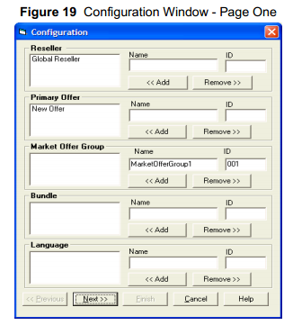
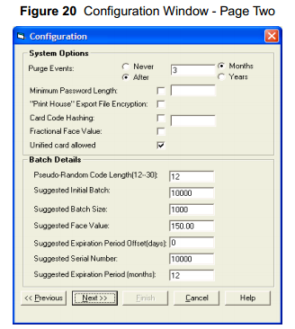
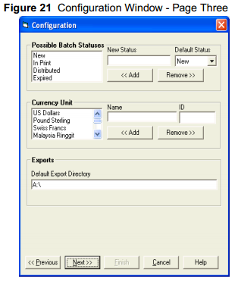
Voucher Tools – User Interface (1)

Slide 5
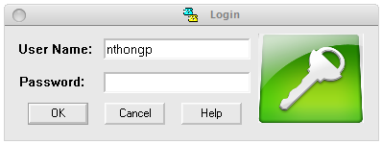
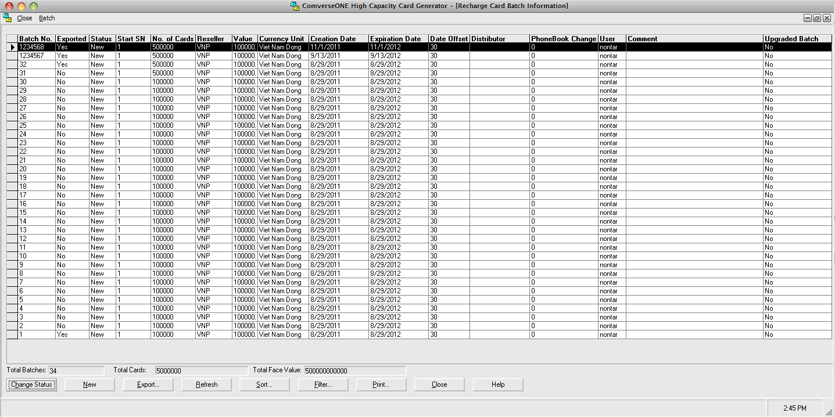
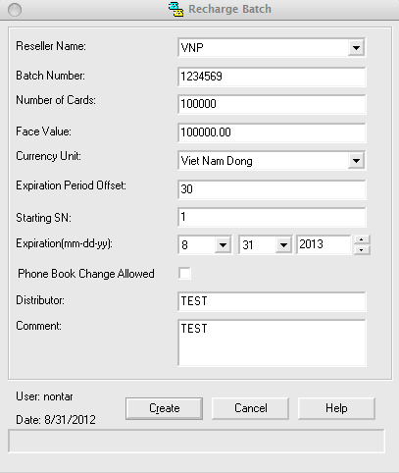
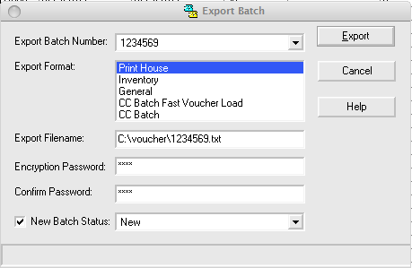
Voucher Tools – User Interface (2)

Slide 6
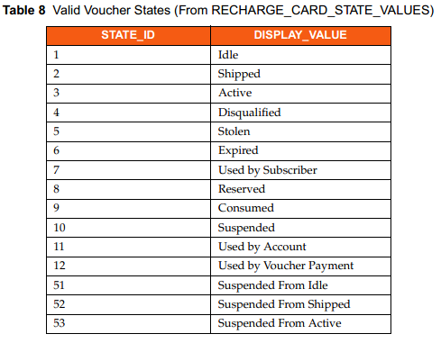
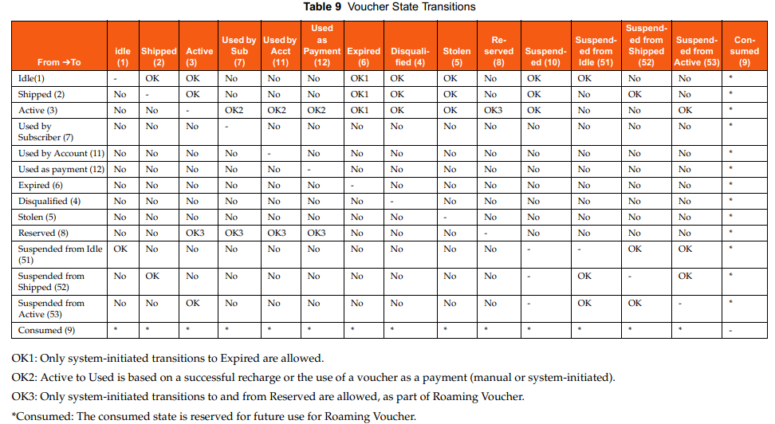
Voucher Tools – State/State Transition

Slide 7
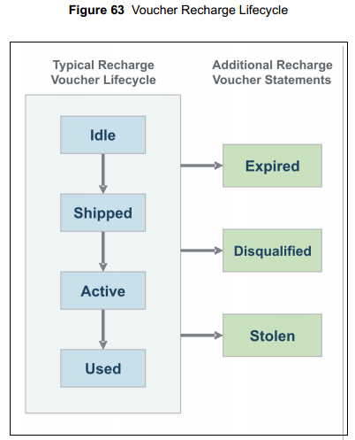
Voucher Tools – Voucher Life Cycle
The following are the state transition rules for vouchers:
The default recharge voucher state is Idle.
The recharge voucher state can transition from Idle to any state other than Used.
The recharge voucher state cannot transition to Idle from any state.
The recharge voucher state cannot transition to any state if it has been set to Disqualified, Expired, Used, or Stolen.
The recharge voucher state cannot transition from Shipped to Used.
The recharge voucher state cannot transition from Active to Shipped.

Slide 8
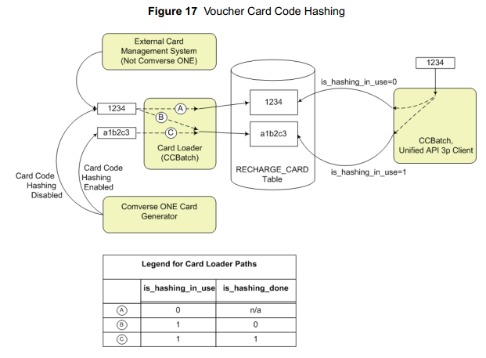
Voucher Tools -- Security
For security purposes, Comverse ONE provides the ability to store voucher card codes in hashed format in the database, using the non-reversible hashing algorithms

Slide 9
Non-Voucher Recharge
Comverse ONE provides an API for non-voucher recharge (as part of the Unified API).
The recharge is being performed by an external system (for example, a system that can accept credit card based recharge requests from the subscriber) without a voucher.
The external system sends the recharge request, including the recharge amount, using this API.
Support for non-currency recharge requests via the non-voucher recharge API.
For example, recharge with 100 SMS units.

Slide 10
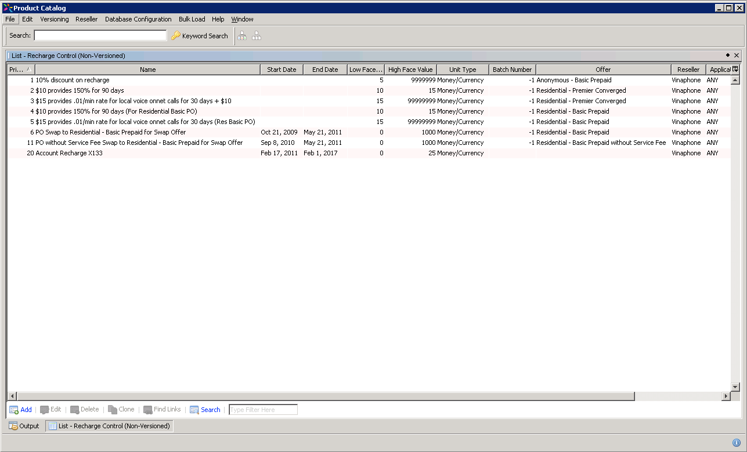
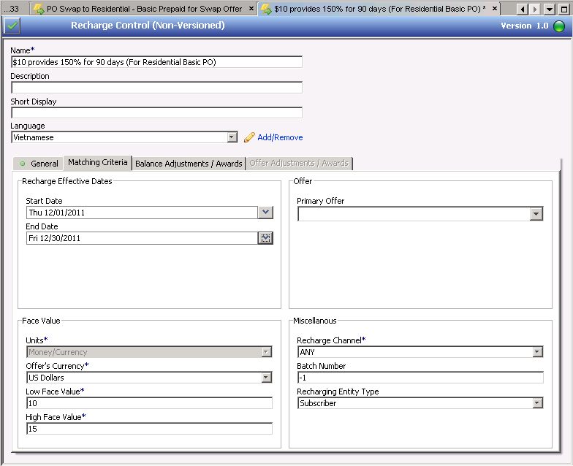
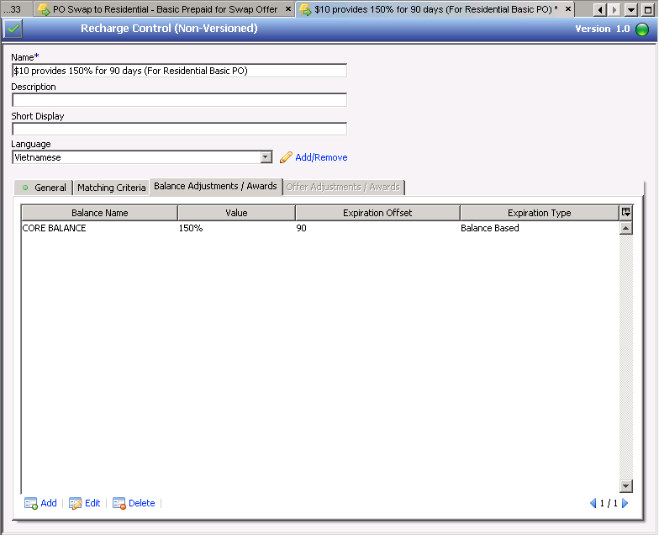
Recharge Control Table

Slide 11
Recommendation
Due to the prepaid will not fully enable in Comverse ONE.
On top of that the RTBS Voucher server will be the main voucher server therefore the integration to RTBS voucher server will be done through the recharge proxy solution.
The Comverse ONE voucher generator may not need to use officially
We will configure and make it readies for ATP

Slide 12
CC Batch

Slide 13
CC Batch
CC Batch application enables bulk creation of recharge vouchers and subscribers. It also provide GUI based interface
In this project CC Batch will be used for batch postpaid migration (either stack migration or bulk migration)
CC Batch processes files containing commands that create vouchers and subscribers. CC Batch interfaces with the Comverse ONE‘s Unified API to provide secure login and other services. CC Batch generates a log file that contains the API’s responses to the executed commands as well as any error response.
CC Batch allows you to create anonymous accounts to support the pre-activation of pre-paid cards. It instantiates an order that does the following:
Creates anonymous accounts and subscribers,
Assigns bundles or primary offers,
Associates MSISDN and SIM/IMSI with the subscribers.

Slide 14
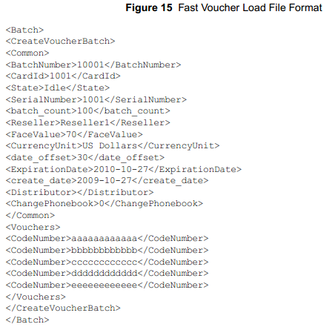
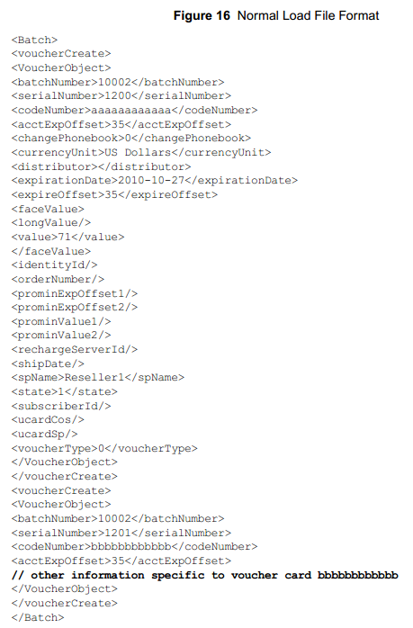
CC Batch – Input (1)
Vouchers information which are generated by Voucher Card generator tools

Slide 15
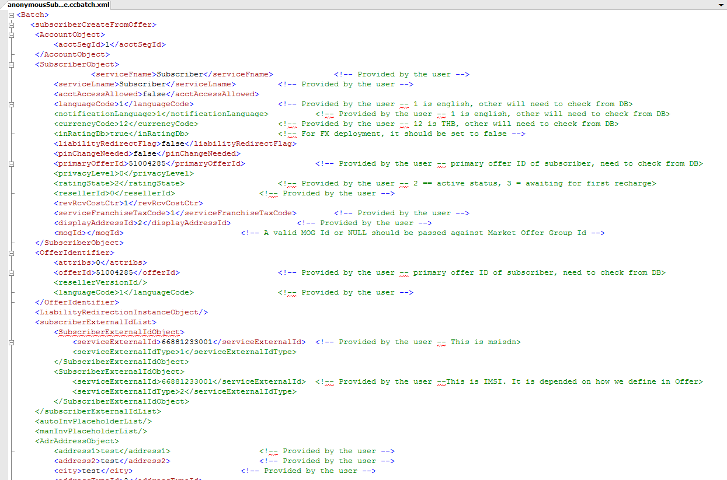
CC Batch – Input (2)
Subscribers information which are provided by BSS system as part of bulk subscriber loading. The file format will be in the XML type.

Slide 16
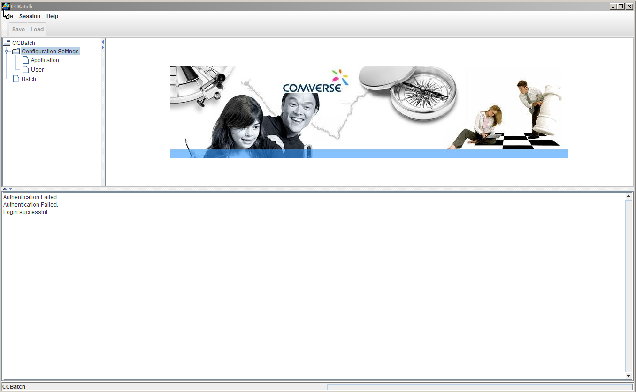
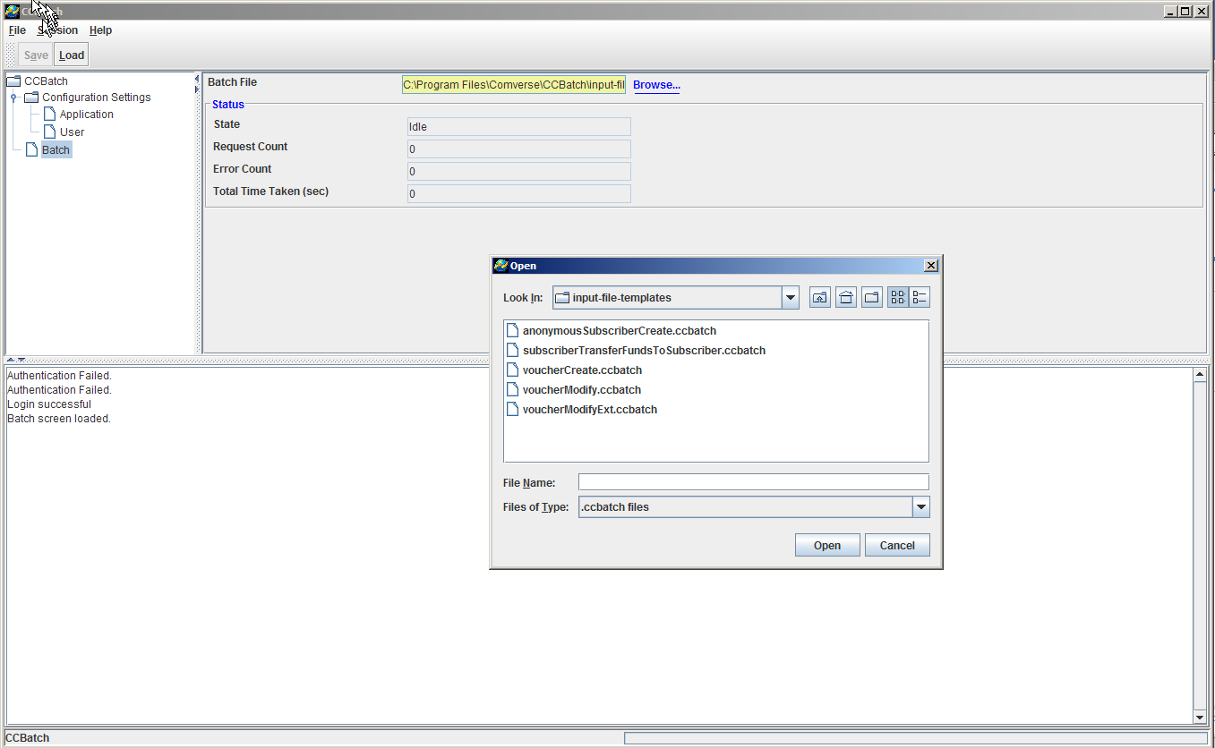
CC Batch – User Interface

Slide 17
Recommendation
Recommendation
We recommend customer to use CC Batch for the following purpose
Stack migration of postpaid subscribers
Bulk migration of postpaid subscribers

Slide 18
Thank you

